Slide 1
Optical Character Recognition using knn
Sanghmitra singh rathore(2017peb5477)
Garima sharma(2017peb5409)
Sachin agnihotri(2017peb5203)

Slide 2
OUTLINE
BACKGROUND
DEFINITION
K-NN IN ACTION
K-NN PROPERTIES
TRAINING SET
CODE
OUTPUT

Slide 3
BACKGROUND
“Classification is a data mining technique used to predict group membership for data instances.”
The group membership is utilized in for the prediction of the future data sets.

Slide 4
ORIGIN OF K-NN
Nearest Neighbors have been used in statistical estimation and pattern recognition already in the beginning of 1970’s (non- parametric techniques).
The method prevailed in several disciplines and still it is one
of the top 10 Data Mining algorithm.

Slide 5

IN A SENTENCE K-NN IS…..
It’s almost like how people judge by observing our peers.
We tend to collaborate with people having similar attributes as ours and the same happens with data too.

Slide 6
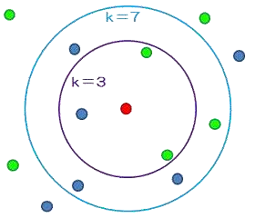
DEFINITION
K-Nearest Neighbor is considered a lazy learning algorithm that classifies data sets based on their similarity with its neighbors.
“K” stands for number of data set items
that are considered for the classification.
Ex: Image shows classification for different k-values.

Slide 7
TECHNICALLY…..
For the given attributes A={X₁, X₂….. X_{D}} Where D is the dimension of the data, we need to predict the corresponding classification group G={Y₁,Y₂…Y_{n}} using the proximity metric over K items in D dimension that defines the closeness of association such that X € R^{D} and Y_{p} € G.

Slide 8


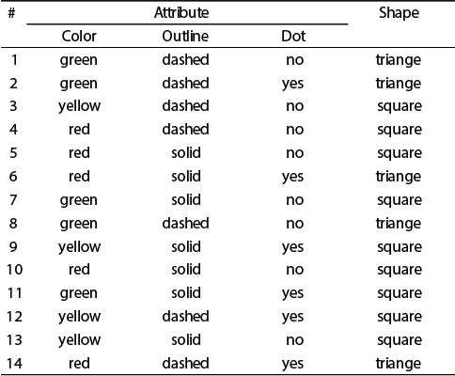
Attributes A
THAT IS….
Attribute A={Color, Outline, Dot}
Classification Group, G={triangle, square}
D=3, we are free to choose K value.
C
l a s s i f i c a t i o n
G
r o u p

Slide 9
PROXIMITY METRIC
Definition: Also termed as “Similarity Measure” quantifies the association among different items.
Following is a table of measures for different data items:
Similarity Measure | Data Format
Contingency Table, Jaccard coefficient, Distance Measure | Binary
Z-Score, Min-Max Normalization, Distance Measures | Numeric
Cosine Similarity, Dot Product | Vectors

Slide 10


PROXIMITY METRIC
For the numeric data let us consider some distance measures:
– Manhattan Distance:
– Ex: Given X = {1,2} & Y = {2,5}
Manhattan Distance = dist(X,Y) = |1-2|+|2-5|
= 1+3
= 4

Slide 11

PROXIMITY METRIC
- Euclidean Distance:
- Ex: Given X = {-2,2} & Y = {2,5}
Euclidean Distance = dist(X,Y) = [ (-2-2)^2 + (2-5)^2 ]^(1/2)
= dist(X,Y) = (16 + 9)^(1/2)
= dist(X,Y) = 5

Slide 12
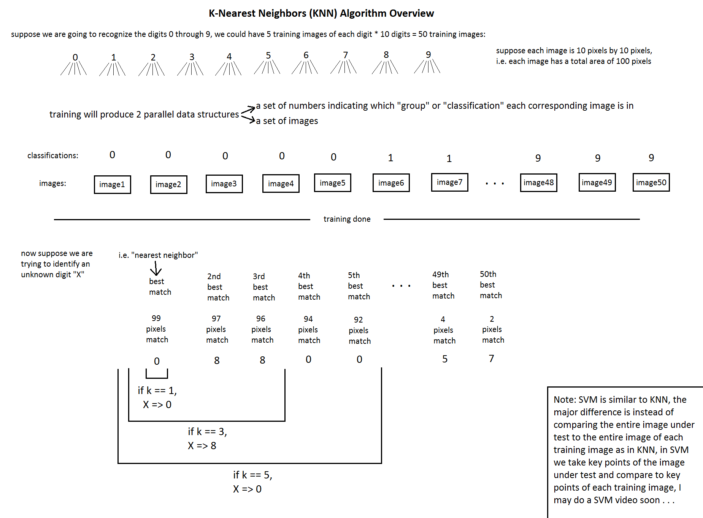

Slide 13

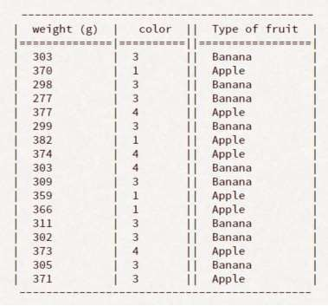
K-NN IN ACTION
Consider the following data: A={weight,color} G={Apple(A), Banana(B)}
We need to predict the type of a
fruit with: weight = 378 color = red

Slide 14

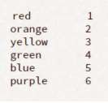
SOME PROCESSING….
Assign color codes to convert into numerical data:
Let’s label Apple as “A” and Banana as “B”

Slide 15

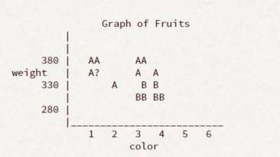

PLOTTING
Using K=3,
Our result will be,
To avoid ties , this k value
should not be a multiple of the number of classes.

Slide 16
REMARKS: PROS..
Advantages
Can be applied to the data from any distribution
for example, data does not have to be separable with a linear boundary
Very simple and intuitive
Good classification if the number of samples is large enough

Slide 17
CONS….
Disadvantages
Dependent on K Value
Test stage is computationally expensive
No training stage, all the work is done during the test stage
This is actually the opposite of what we want. Usually we can
afford training step to take a long time, but we want fast test step
Need large number of samples for accuracy

Slide 18
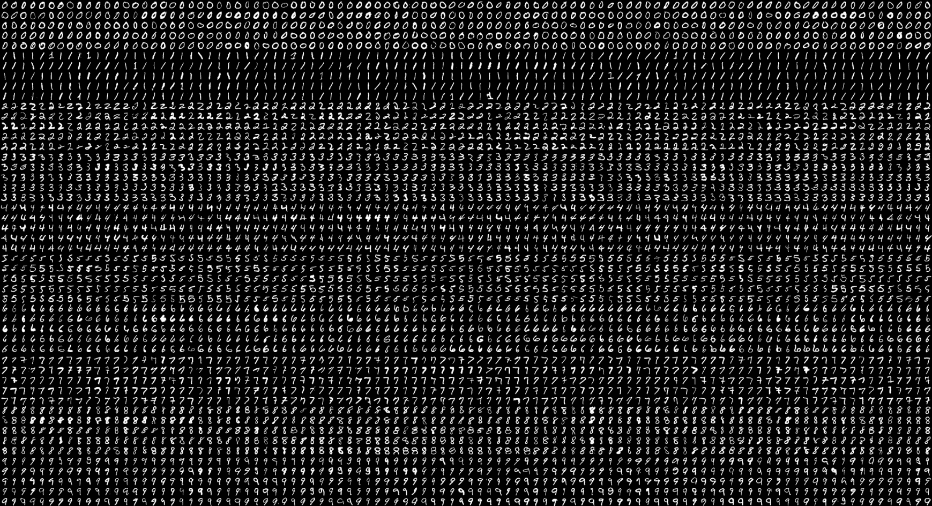
TRAINING DATA…..

Slide 19
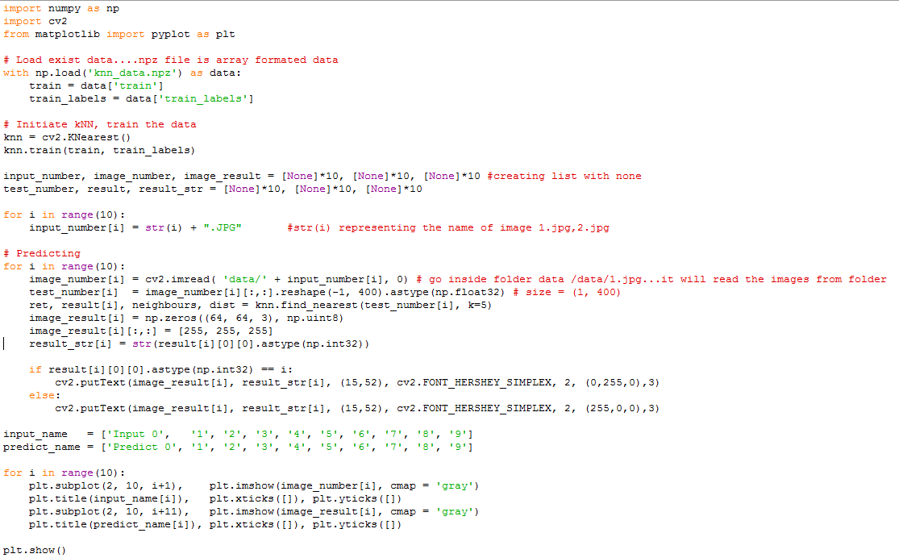
CODE….

Slide 20
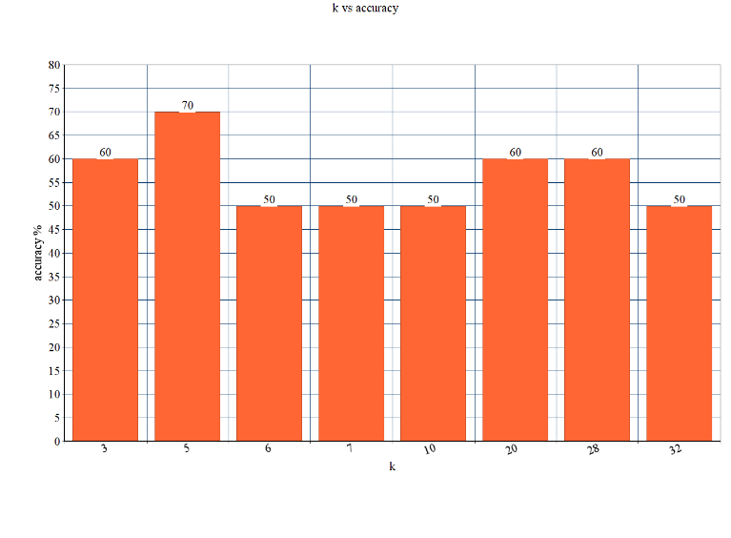
K vs accuracy…

Slide 21
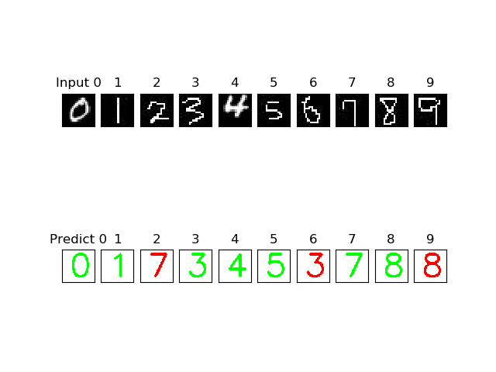

Slide 22
Thank you

